Slide 1
Data Structures & Algorithms SECP2043

Slide 2
Linked List
A linked list is a collection of components, called nodes.
Every node (except the last node) contains the address of the next node.
Thus, every node in a linked list has two components:
one to store the relevant information (that is, data)
and one to store the address, called the link of the next node in the list.
The address of the first node in the list is stored in a separate location, called the head or first.
The order of the nodes is determined by the address, called the link, stored in each node.

Slide 3
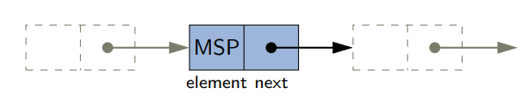
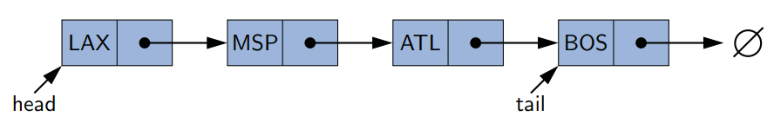
Diagrammatic Representation

Slide 4
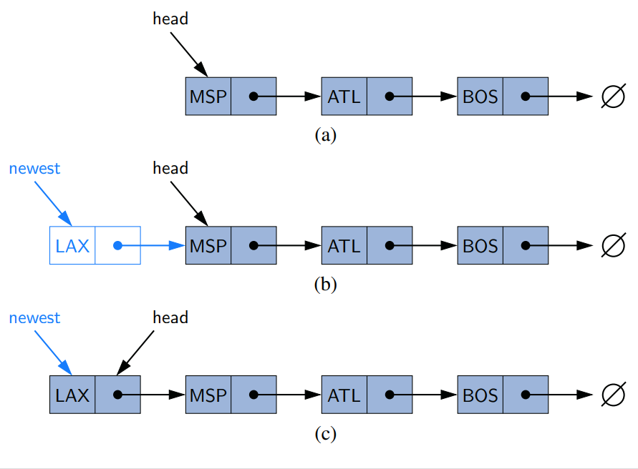
Diagrammatic Representation

Slide 5
Linked Lists Implementation Through Classes
We need to declare each node as a class as each node of a linked list has two components.
The data type of each node depends on the specific application.
However, the link component of each node is a pointer of node type itself.
The definition of the node is as follows. (Assume that the data type is int.)

Slide 6
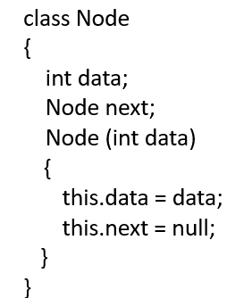

Slide 7
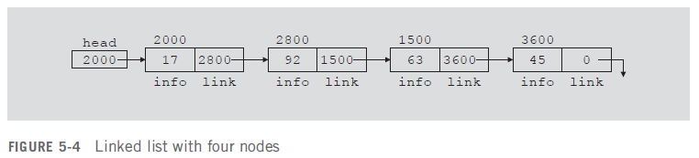
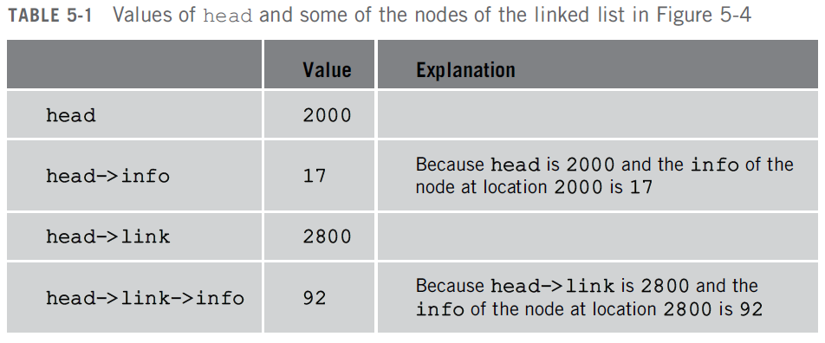
Linked Lists Properties

Slide 8
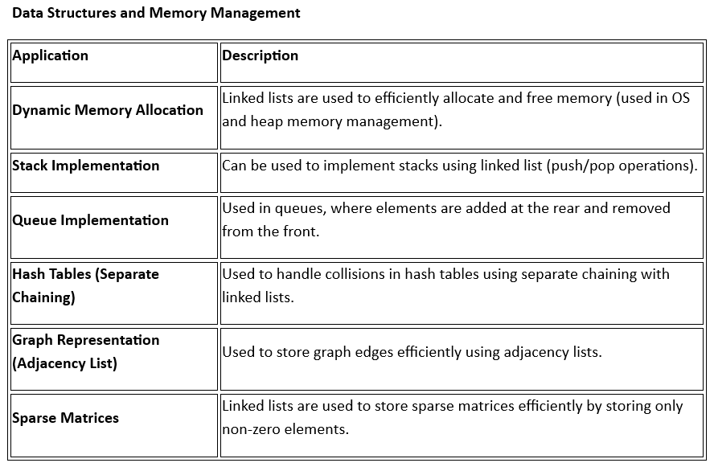
Applications of Linked Lists

Slide 9
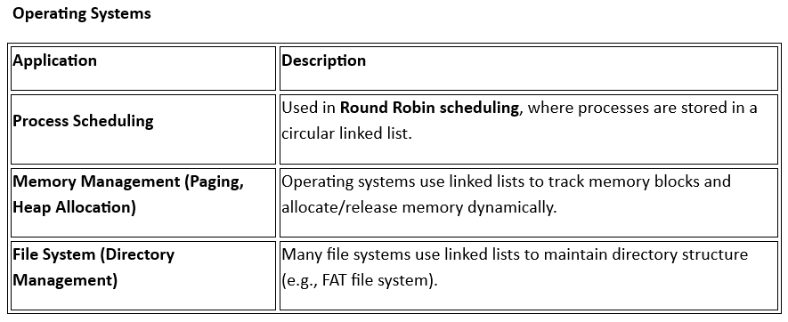

Slide 10
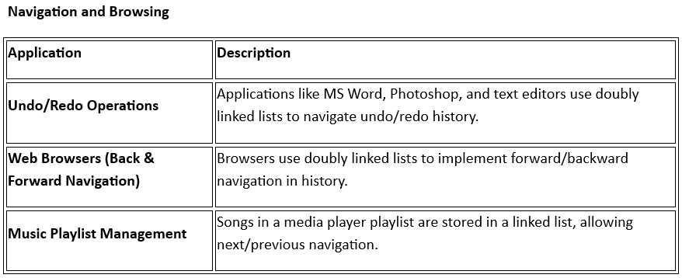

Slide 11
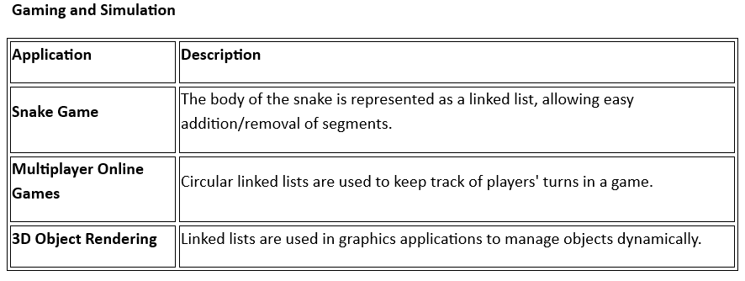

Slide 12
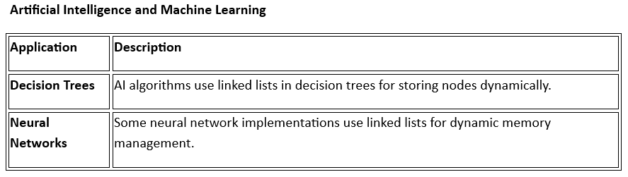

Slide 13
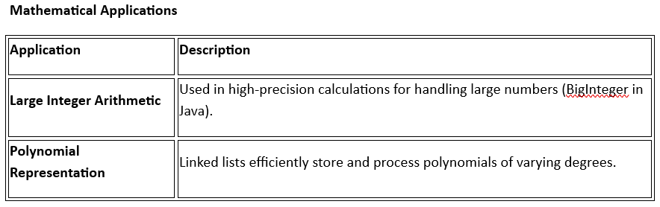

Slide 14
